Slide 1
Safety Measures for Covid
Fall 2020 - Internet of Things (CS-426-01 CS-580I) Project Proposal
By-
Mehul Vani

Slide 2
Contents
Motivation
Proposed Topic
Proposed Method
Hardware / Software

Slide 3
Motivation
Crucial Time - Pandemic
Safety Measure -
Mask Detection
Body Temperature
Where to enforce?

Slide 4
Summary of Proposed Topic
A system that helps take preventive measures against the coronavirus, firstly by detecting whether or not a person is wearing a mask and secondly by checking his/her body temperature being normal or not. Only if the two conditions are met door will be automatically unlocked or else will be left locked and entry will be prohibited.

Slide 5
CAMERA
MASK DETECTION
Proposed Methodology
DOOR UNLOCKED
IR SENSOR
BODY TEMPERATURE

Slide 6
ADVANTAGES
Automatic Mask Detection and body temperature
Automatic Door Operation - prevents unnecessary contact with doors
USAGE
Universities Rooms
Dining Halls
Malls and Shops

Slide 7
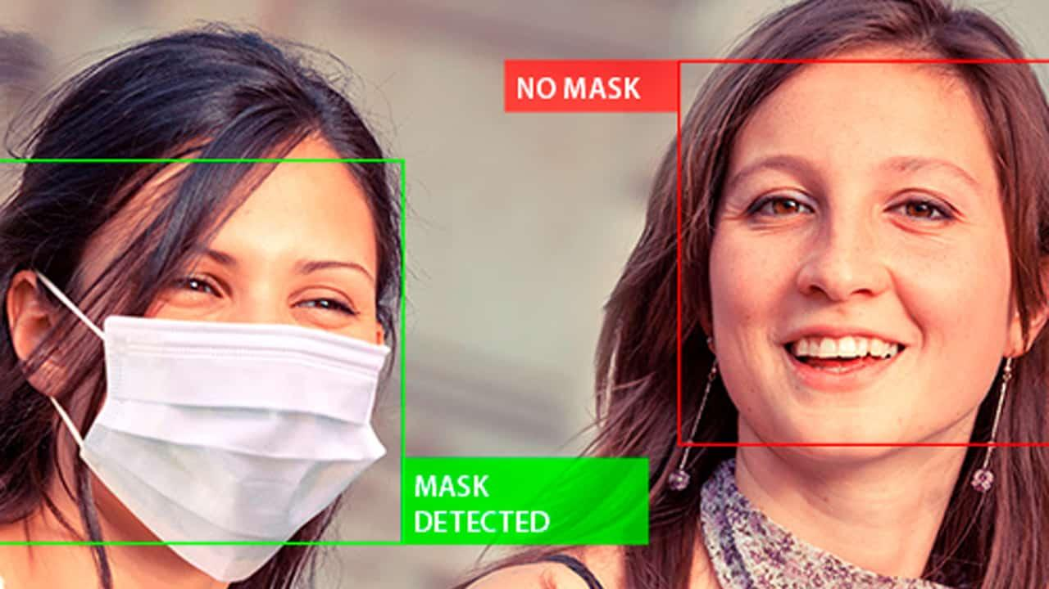
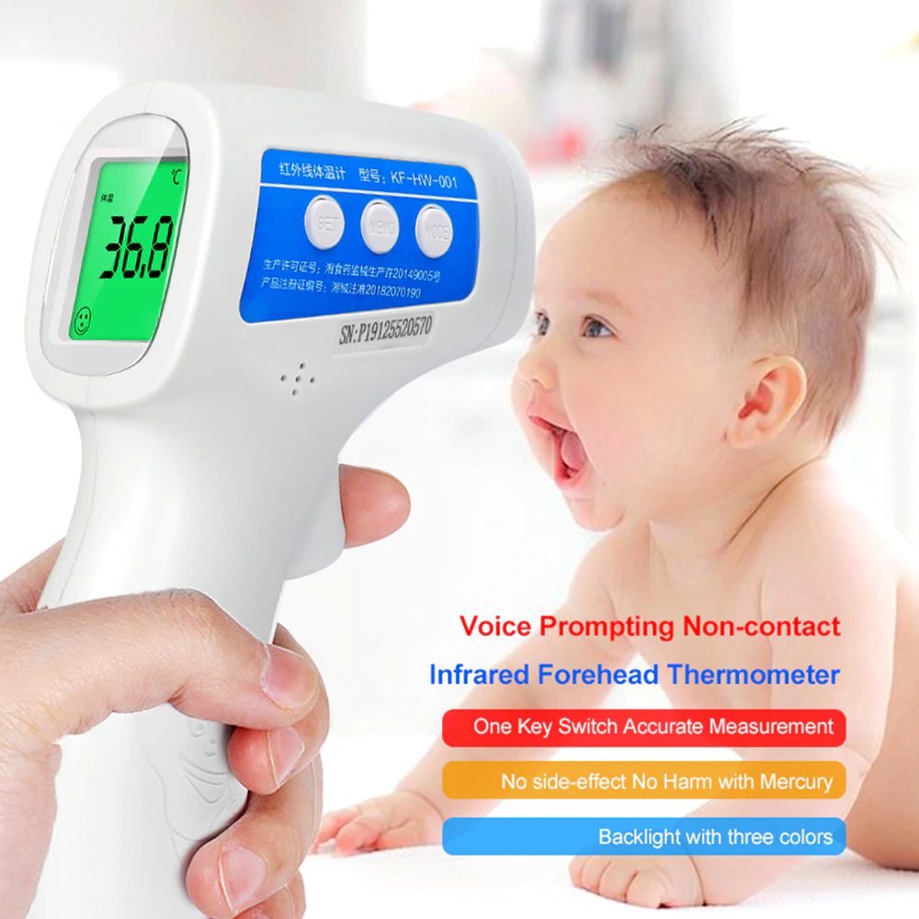
Images
Temperature detection
Face detection

Slide 8
Hardware / Software
Raspberry-pi 3
Camera Module, laptop or phone camera will work
I.R. Sensor (Infrared Sensor)
Alarm (Instead of door lock, I will be using an alarm)
Python , nodejs

Slide 9
THANK YOU FOR LISTENING!!
ANY QUESTIONS?

